Slide 1
OWASP SAMM2 – Your Dynamic Software Security Journey
Bart De Win Sebastien Deleersnyder
bart.dewin@owasp.org seba@owasp.org
OWASP SAMM2, OWASP Global AppSec, Amsterdam 2019

Slide 2
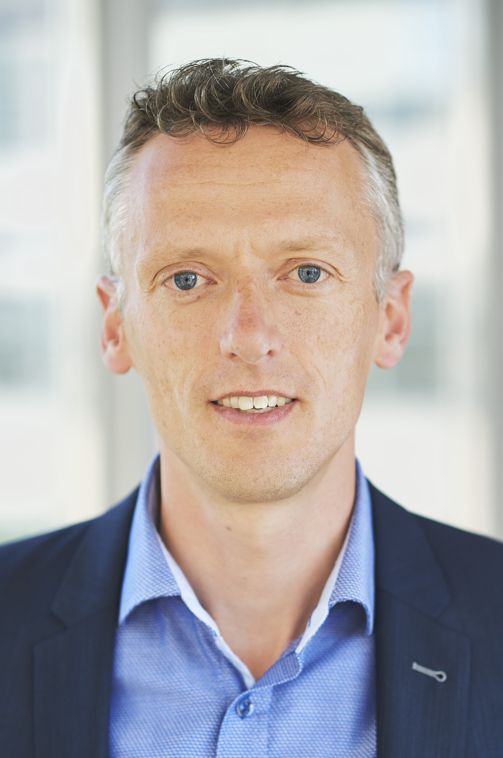
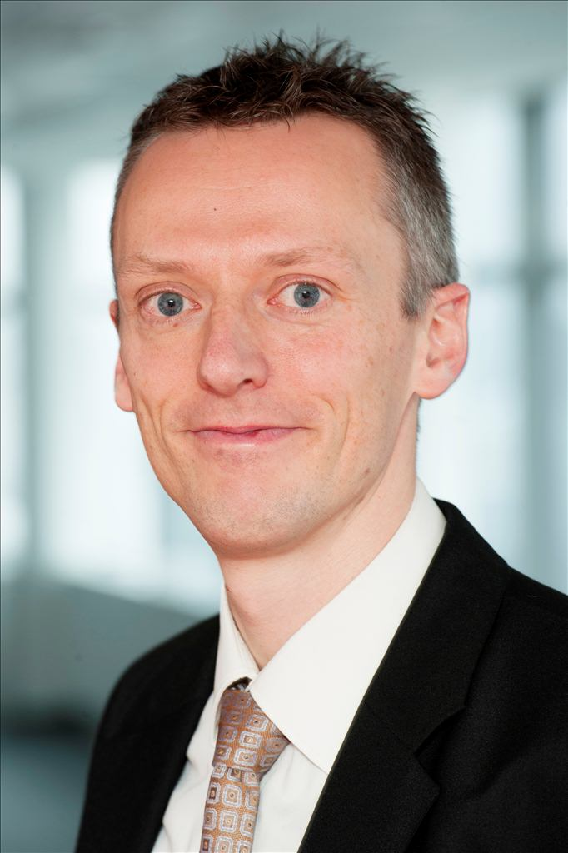

Bart?
Bart De Win, Ph.D.
20+ years experience in software security
Belgian OWASP chapter co-leader
OWASP SAMM co-leader and evangelist
Author of >60 publications
Director & security consultant @PwC BE
Bart.de.win@pwc.com
OWASP SAMM2, OWASP Global AppSec, Amsterdam 2019

Slide 3

What is SAMM?
“The mission of OWASP SAMM is to be the prime maturity model for software assurance that provides an effective and measurable way for all types of organizations to analyse and improve their software security posture. OWASP SAMM supports the complete software lifecycle, including development and acquisition, and is technology and process agnostic. It is intentionally built to be evolutive and risk-driven in nature.”
OWASP SAMM2, OWASP Global AppSec, Amsterdam 2019

Slide 4



Why a maturity model?
Measurable
Actionable
Versatile
An organization’s behavior changes slowly over time
Changes must be iterative while working toward long-term goals
There is no single recipe that works for all organizations
A solution must enable risk-based choices tailored to the organization
Guidance related to security activities must be prescriptive
A solution must provide enough details for non-security-people
Overall, must be simple, well-defined, and measurable
OWASP Software Assurance Maturity Model (SAMM)
OWASP SAMM2, OWASP Global AppSec, Amsterdam 2019

Slide 5
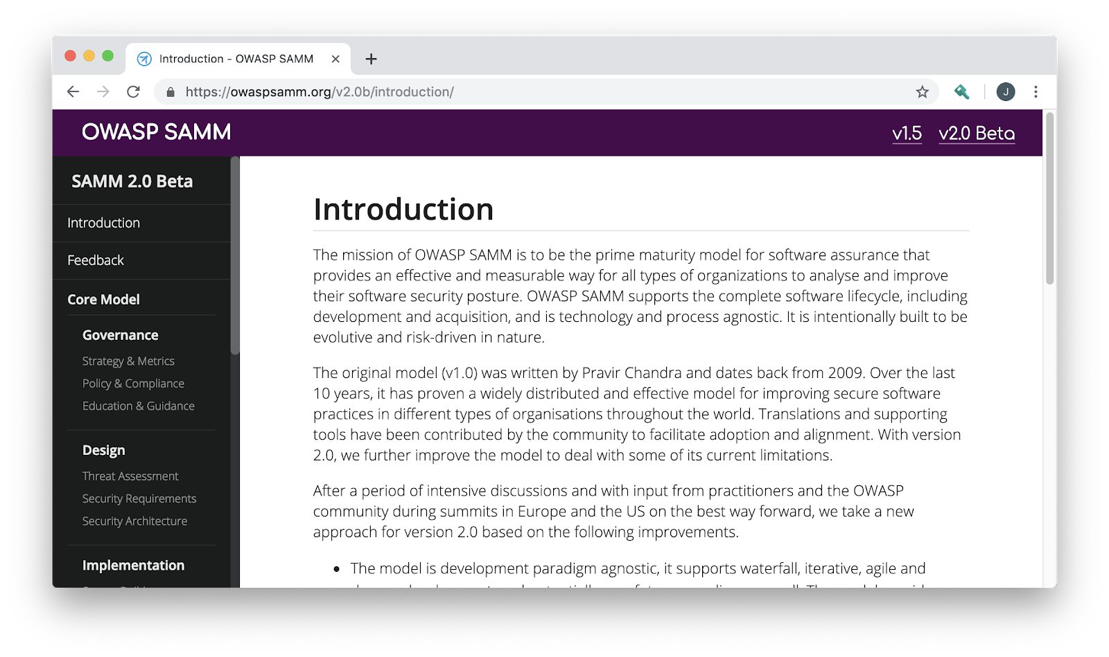
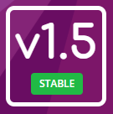
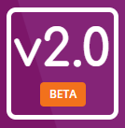
OWASP SAMM
https://owaspsamm.org/
OWASP SAMM2, OWASP Global AppSec, Amsterdam 2019

Slide 6
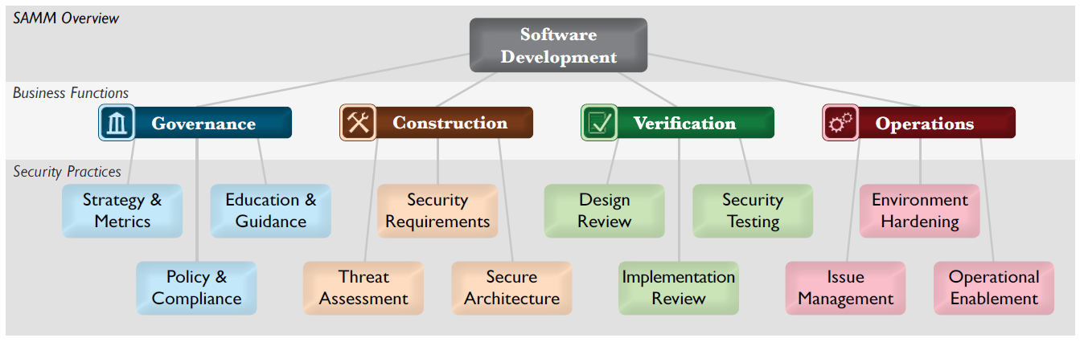
Core structure

Slide 7
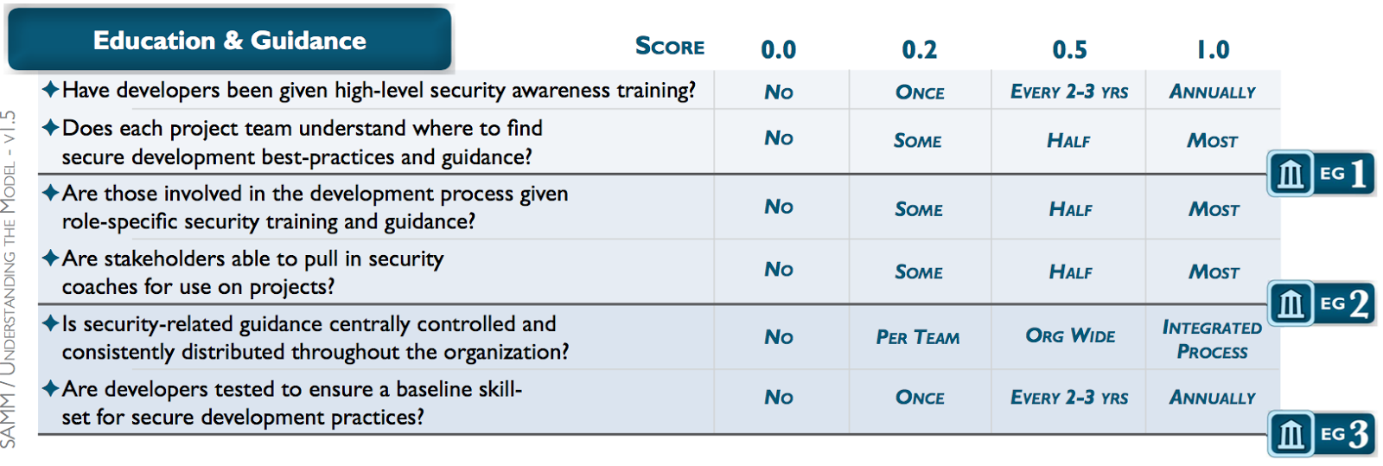
Assessments

Slide 8
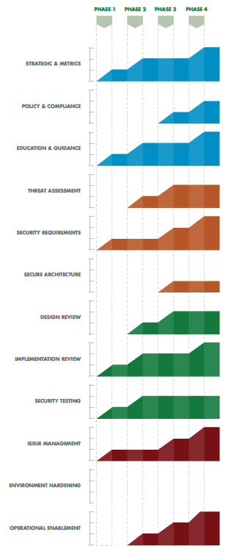
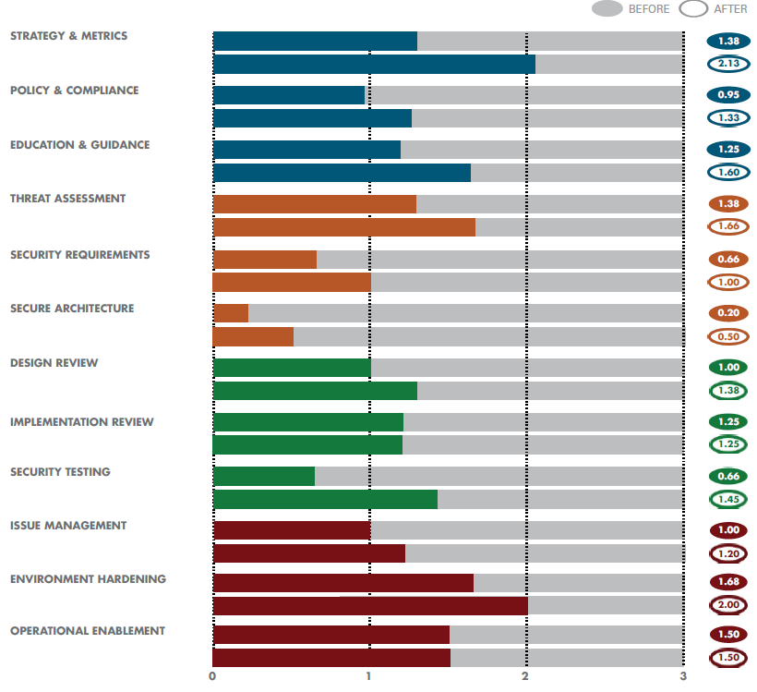
SAMM output
OWASP SAMM2, OWASP Global AppSec, Amsterdam 2019

Slide 9
Why a new version?
Align with recent development practices
“Orphaned” activities
Method agnostic
Improve assessments
Improve production process
Backwards compatibility was not a goal
OWASP SAMM2, OWASP Global AppSec, Amsterdam 2019

Slide 10
SAMM2 business functions
Governance
Design
Implementation
Verification
Operations
OWASP SAMM2, OWASP Global AppSec, Amsterdam 2019

Slide 11
SAMM2 security practices
Governance
Strategy & Metrics
Policy & Compliance
Design
Threat Assessment
Security Requirements
Implementation
Secure Build
Education & Guidance
Security Architecture
Secure Deployment
Defect Management
Verification
Architecture Assessment
Requirements Testing
Security Testing
Operations
Incident Management
Environment Management
Operational Management
Still 3 Security Practices per Business Function
OWASP SAMM2, OWASP Global AppSec, Amsterdam 2019

Slide 12
SAMM2 security practice structure
Streams
Maturity
 | A: Control Verification | B: Misuse/Abuse Testing
Level 1 - Opportunistically find basic vulnerabilities and other security issues. | Test for standard security controls | Perform security fuzzing testing
Level 2 - Perform implementation review to discover application-specific risks against the security requirements. | Derive test cases from known security requirements | Create and test abuse cases and business logic flaw test
Level 3 - Maintain the application security level after bug fixes, changes or during maintenance | Perform regression testing (with security unit tests) | Denial of service and security stress testing
Activities
OWASP SAMM2, OWASP Global AppSec, Amsterdam 2019

Slide 13
SAMM2 framework overview
Governance
Strategy & Metrics | Create and Promote | Measure and Improve
Policy & Compliance | Policy and Standards | Compliance Management
Education & Guidance | Training and Awareness | Organization and Culture
Design
Threat Assessment | Application Risk Profile | Threat Modeling
Security Requirements | Software Requirements | Supplier Security
Secure Architecture | Architecture Design | Technology Management
Implementation
Secure Build | Build Process | Software Dependencies
Secure Deployment | Deployment Process | Secret Management
Defect Management | Defect Tracking (Flaws/Bugs/Process) | Metrics and Feedback/Learning
Verification
Architecture Assessment | Architecture Validation | Architecture Compliance
Requirements Testing | Control Verification | Misuse/Abuse Testing
Security Testing | Scalable Baseline | Deep Understanding
Operations
Incident Management | Incident Detection | Incident Response
Environment Management | Configuration Hardening | Patching and Updating
Operational Management | Data Protection | System decommissioning / Legacy management
OWASP SAMM2, OWASP Global AppSec, Amsterdam 2019

Slide 14
Scoring in SAMM v1.5
Strategy & Metrics, Level 1: Is there a software security assurance program in place?
Available Responses:
No
Yes, it‘s less than a year old
Yes, it‘s a number of years old
Yes, it‘s a pretty mature program
But, what about…
Quality of the program?
Freshness of the program? Has it been reviewed/updated?
How do you know the program is still relevant?
OWASP SAMM2, OWASP Global AppSec, Amsterdam 2019

Slide 15
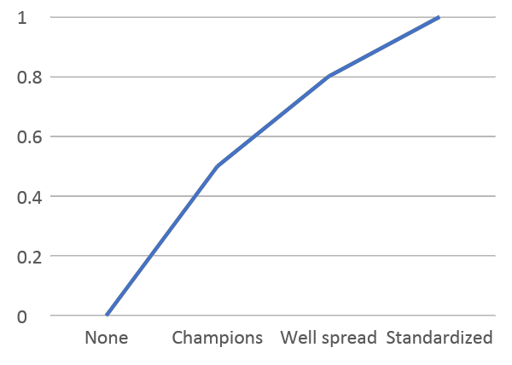
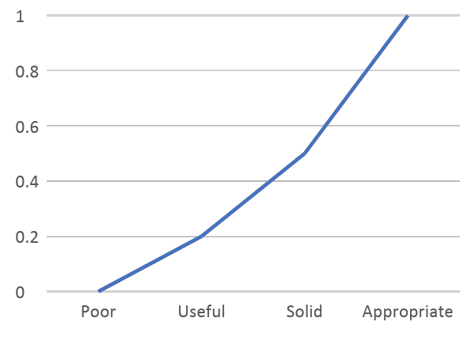
Multiple dimensions to consider
Coverage
Quality
SAMM2: Questions
SAMM2: Quality criteria (mandatory)
OWASP SAMM2, OWASP Global AppSec, Amsterdam 2019

Slide 16
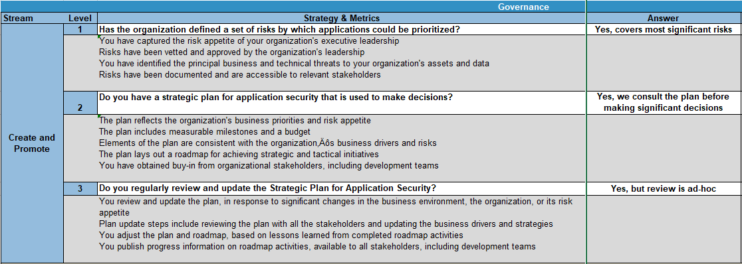
SAMM2 assessments
OWASP SAMM2, OWASP Global AppSec, Amsterdam 2019

Slide 17
Project: new way of working
Single source of the truth (Github)
Used to generate everything automatically
Document, website
Toolbox
Applications
OWASP SAMM2, OWASP Global AppSec, Amsterdam 2019

Slide 18
Community involvement
Core Structure
BF’s, practices, streams
Evaluation Model
Questions, quality criteria, measurement model
Project driven
Activity Model
Objectives, Activities, dependencies, metrics, ...
Community feedback
Supporting information / tools
Guidance, references, supporting tools, ...
Community driven
OWASP SAMM2, OWASP Global AppSec, Amsterdam 2019

Slide 19
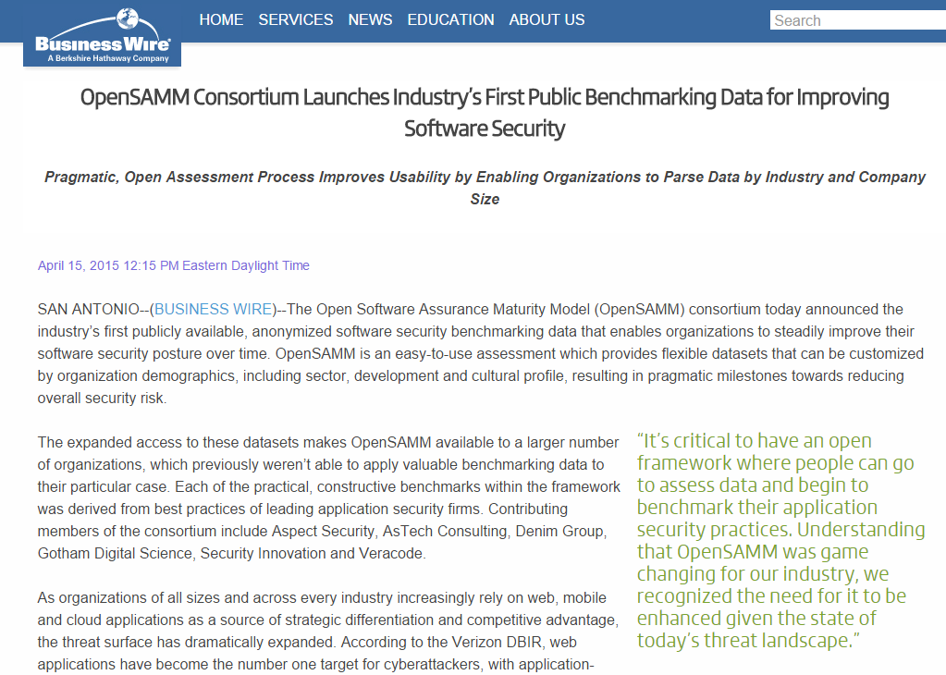
How do I compare to?
OWASP SAMM2, OWASP Global AppSec, Amsterdam 2019

Slide 20

Current roadmap
V2.0: end of 2019
2020:
v2.1, 2.2, ...: iterative releases
Agile/devops guidance
Roadshows/trainings
OWASP SAMM2, OWASP Global AppSec, Amsterdam 2019

Slide 21
Looking forward
Online assessments, integrated with benchmark data
User community contributions
Support for regulations
User events
...

Slide 22

Try it !
OWASP SAMM2, OWASP Global AppSec, Amsterdam 2019

Slide 23




Credits
Sebastien (Seba) Deleersnyder – Project Co-Leader, Belgium
Bart De Win – Project Co-Leader, Belgium
Brian Glass – United States
Daniel Kefer – Germany
Yan Kravchenko – United States
Chris Cooper – United Kingdom
John DiLeo – New Zealand
Nessim Kisserli – Belgium
Patricia Duarte - Bolivia
John Kennedy - Sweden
Hardik Parekh - United States
John Ellingsworth - United States
Sebastian Arriada - Brasil
Brett Crawley – United Kingdom
https://owaspsamm.org/sponsors/
OWASP SAMM2, OWASP Global AppSec, Amsterdam 2019

Slide 24
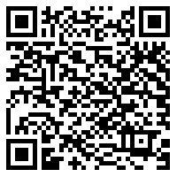
News / Become involved
Website (https://owaspsamm.org/)
Slack (OWASP - #project-samm)
Newsletter
Mailinglist (info@owaspsamm.org)
Github (https://github.com/OWASP/samm/)
OWASP SAMM2, OWASP Global AppSec, Amsterdam 2019

Slide 25

Questions or Feedback ?
OWASP SAMM2, OWASP Global AppSec, Amsterdam 2019

